Slide 1
CSE 4165: Web Programming
Lecture 3

Slide 2
The properties that have been taught to you
If you were asked now, could you explain the following CSS properties? Also which ones apply to which type of tag (inline/block)?
width
height
background-color
color
padding (padding-left, padding-right, padding-top, padding-bottom)
margin (margin -left, margin -right, margin -top, margin -bottom)
border-style, border-color, border-width, border-radius

Slide 3
Some more properties we will learn about
You may have seen a few of these already!
margin (a bit more)
float (and clear)
display
background
position
overflow
box-sizing
Text-related properties
box-shadow
opacity
cursor
max-width
min-width
object-fit

Slide 4
Margin
We have seen margin-left, margin-right, margin-top, margin-bottom
What happens if there is no more room for margins? (imagine you are in crowded a lift during covid time )

Slide 5
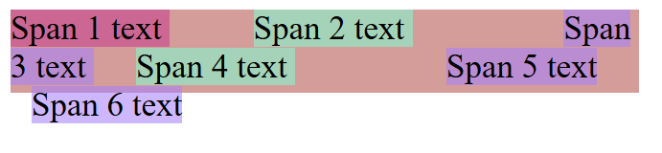
Margin
We have seen margin-left, margin-right, margin-top, margin-bottom
What happens if there is no more room for margins? (imagine you are in crowded a lift during covid time )
For inline elements: Try to get this done
yourself using margin-left and margin-right

Slide 6
Margin
We have seen margin-left, margin-right, margin-top, margin-bottom
What happens if there is no more room for margins? (imagine you are in crowded a lift during covid time )
For inline elements: Try to get this done
yourself using margin-left and margin-right

Slide 7
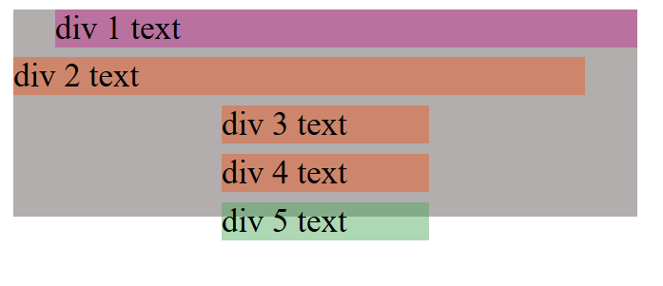
Margin
We have seen margin-left, margin-right, margin-top, margin-bottom
What happens if there is no more room for margins? (imagine you are in crowded a lift during covid time )
For block elements: Let us do it now!

Slide 8
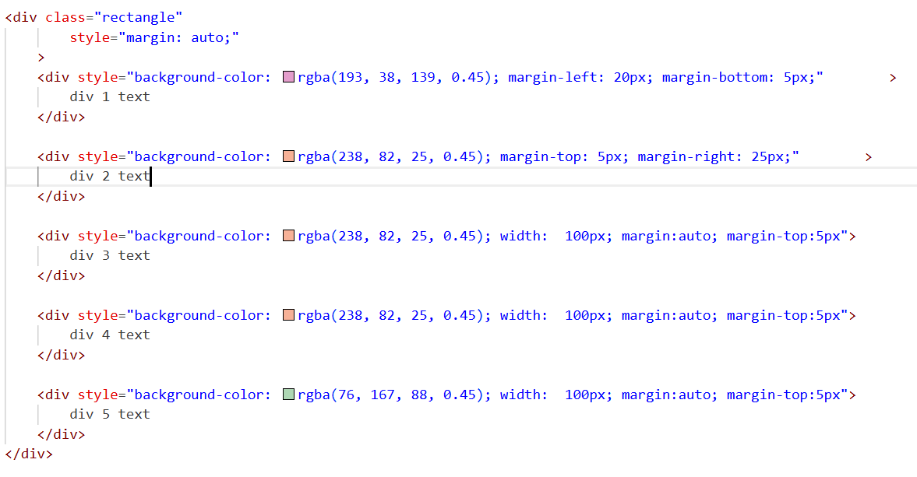
Margin

Slide 9
Margin
Observations: If due to margins, the inside of a container becomes too crowded, the elements may come out.
Note regarding margin : auto – you must set the width before using it.
Will margin-auto work on inline elements?
Why? Why not?
Notes:
Ans: No it will not and inline elements do not have a specified width

Slide 10
display
So we can convert between tag types as we just saw.
Can we do it arbitrarily? Yes!
display: block;
display: inline;
display: inline-block;

Slide 11
display
So we can convert between tag types as we just saw.
Can we do it arbitrarily? Yes!
display: block;
display: inline;
display: inline-block;

Slide 12
display
display: inline-block;
It stops taking the full width of the parent.
It no longer forces a new line.
It can sit next to other inline / inline-block elements.
You can still set width and height.
Basically it converts a tag into an inline tag like span, but unlike a regular span, you can adjust its width and height

Slide 13
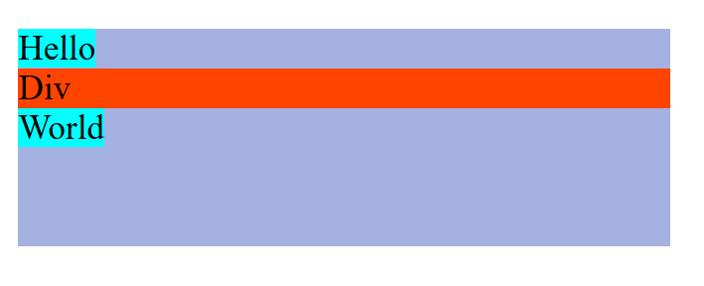
display
A span, then a div, then another span

Slide 14

display
Make the div inline-block (it just looks inline)

Slide 15
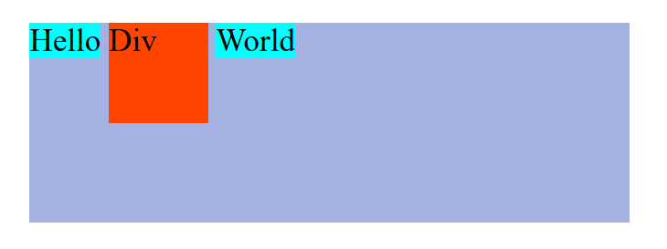
display
Set its width and height (50px by 50px)

Slide 16
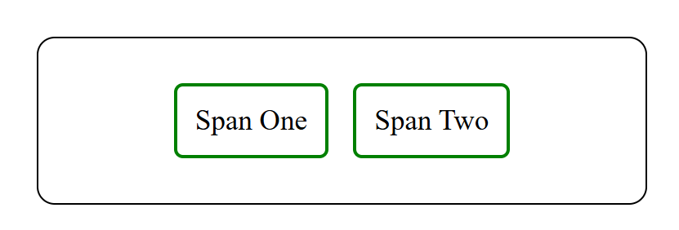
border
border: 1px solid black;
border-radius: 10px;
Do it yourselves!

Slide 17
Position
This CSS property is self explanatory:
position: static (default)
position: relative
position: absolute
position: fixed
A file titled demoPosition.html has been shared with you.
Let us explore it.

Slide 18
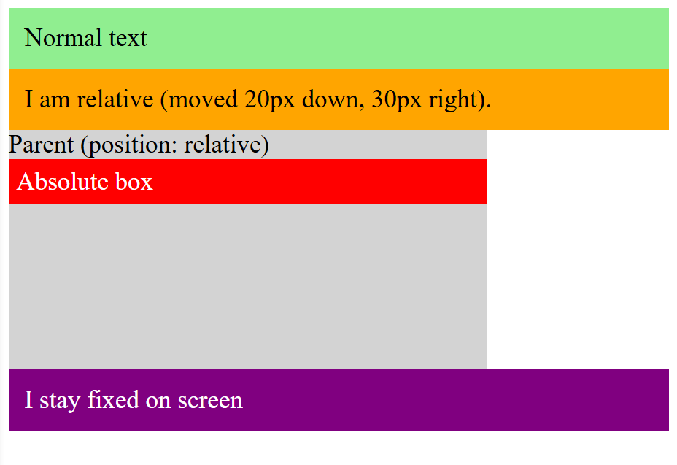
Remove all the position related attributes

Slide 19
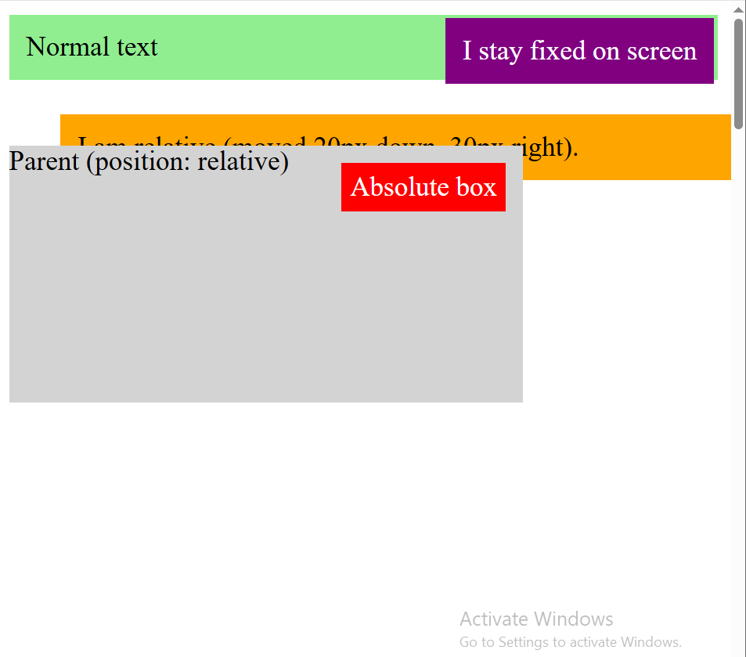
Place the position related attributes one at a time

Slide 20
Overflow
overflow: visible (default)
overflow: hidden
overflow: scroll
overflow: auto (scroll but only when needed)
overflow-x and overflow-y
A page titled demoOverflow.html has been shared with you. Download it and observe

Slide 21
Box-size
box-sizing : content-box:
width = content only
padding + border expand outward
Text does NOT move inward
Box-sizing : border-box:
width includes content + padding + border
padding + border use space inside the width
Text IS pushed inward
Download the file demoBoxSize.html

Slide 22
Text Related Properties
The properties are self explanatory.
font-size
color
font-family
font-weight
text-align
line-height
text-decoration
letter-spacing
word-spacing
text-transform
Download the file and observe side by side.

Slide 23
Home work - background
background-color – you already know
background-image
background-size
background-repeat

Slide 24
Three cool CSS properties
box-shadow - makes boxes look lifted
opacity - controls transparency
cursor - changes mouse pointer (use pointer for buttons
Download the demoCool.html file

Slide 25
Last Three Properties
max-width : Sets the maximum width an element can grow to
min-width : Sets the minimum width an element must keep
object-fit : Controls how an image fits inside its box
Download the file demolast3.html and check

Slide 26
Thank You

